Slide 1


NEXT GEN EMPLOYABILITY PROGRAM
CREATING A FUTURE-READY WORKFORCE
Student Name :
TASIKUL ISLAM
College Name :
GOVERNMENT COLLEGE OF ENGINEERING & TEXTILE TECHNOLOGY,SERAMPORE
Student ID :
STU67908eec983281737527020

Slide 2
CAPSTONE PROJECT SHOWCASE
Project Title
FULL STACK WEB DEVELOPMENT WITH MERN(ZOMATO CLONE)
Abstract | Problem Statement | Project Overview | Proposed Solution | Technology Used | Modelling & Results | Conclusion | Q&A

Slide 3
Abstract
1
User-Centric Food Delivery Platform
Seamlessly connects users to nearby restaurants, enhancing food discovery and personalization.
2
Scalable Food Ordering Application
Built using the MERN stack to handle real-time orders, high traffic, and multiple user roles.
3
Modern Restaurant Management and Food Delivery
Admin features allow restaurants to manage menus, view orders, and update availability dynamically.
4
Comprehensive Food Discovery and Ordering Platform
eatures like “Order Online”, “Dining”, and “Live Events” ensure a 360° food experience.

Slide 4


Problem Statement
Title:
"Build a Full-Stack Restaurant Aggregator and Food Ordering Platform"
Objective:
Create a scalable and responsive MERN-based web app replicating Zomato’s features, enabling users to browse restaurants, order food, and manage profiles, with admin control for restaurant management.
Description:
With rising demand for food delivery apps, this project offers hands-on full-stack development experience. It supports two user types: customers and admins, similar to Zomato.

Slide 5

Project Overview
Key Features:
Secure login/signup with JWT.
Browse restaurants by cuisine, location, or popularity.
View detailed menus and pricing.
Add to cart, review, and place orders.
Admin can manage and update restaurant info.
React-based responsive UI.
Outcome:
Demonstrates full-stack development using modern tools, focusing on usability, scalability, and real-world implementation.

Slide 6
Proposed Solution
Tech Stack: MERN (MongoDB, Express.js, React.js, Node.js)
Backend: Node.js/Express.js for API endpoints, MongoDB for storing restaurant & user data.
Frontend: React.js for a dynamic and responsive UI.
Integration: Uses Axios/Fetch for API calls, Redux/Context API for state, and Google Maps/Mapbox for location.
Key Features:
Homepage: Restaurant listings with search/filter.
Menu & Cart: View items, add to cart, place/view orders.
Deployment:
Backend: Hosted on Render/Heroku
Frontend: Deployed via Vercel
CI/CD: GitHub Actions

Slide 7
Technology used
Frontend:
React.js: For building dynamic and responsive user interfaces.
React Router: For routing between pages (Home, Login, Restaurant Details, etc.).
Axios: For making HTTP requests to the backend.
Backend:
Node.js: JavaScript runtime for handling server-side operations.
Express.js: Framework for building RESTful APIs.
JWT (JSON Web Tokens): For secure user authentication and authorization.
Bcrypt.js: For password hashing to enhance security.
Database:
MongoDB: NoSQL database for storing users, restaurants, and menu data.
Mongoose: For schema modeling and interaction with the MongoDB database.
Development Tools:
Postman: For API testing.
VS Code: Code editor for development.
Environment:
Dotenv: For managing environment variables (e.g., database URI, JWT secret).

Slide 8
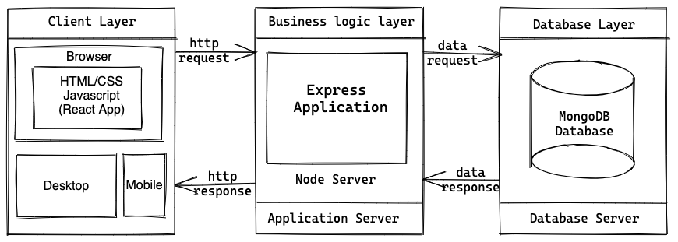
Modelling & Result

Slide 9
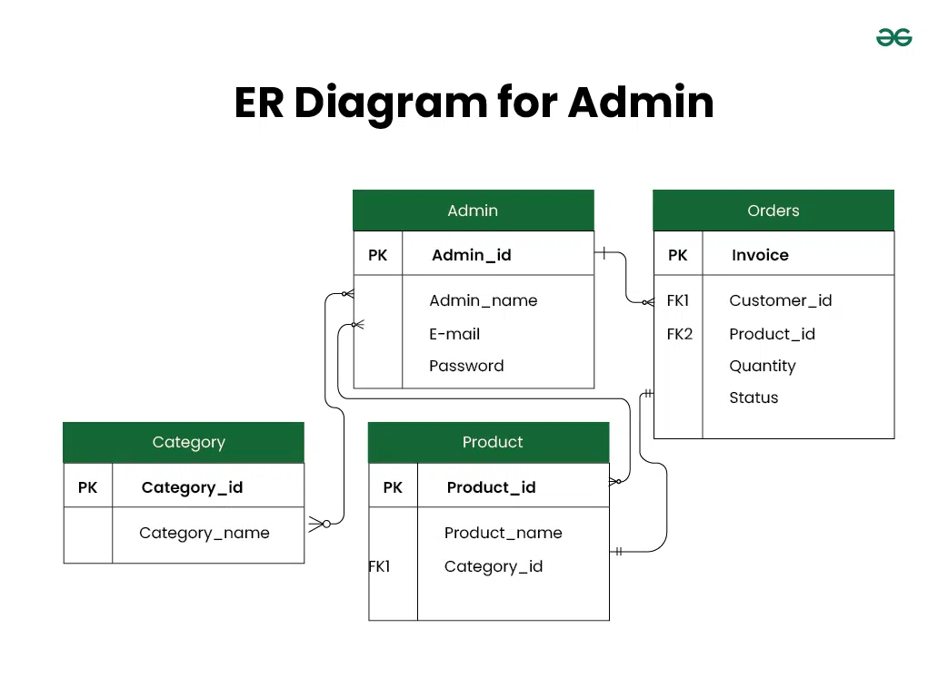
Modelling & Result

Slide 10
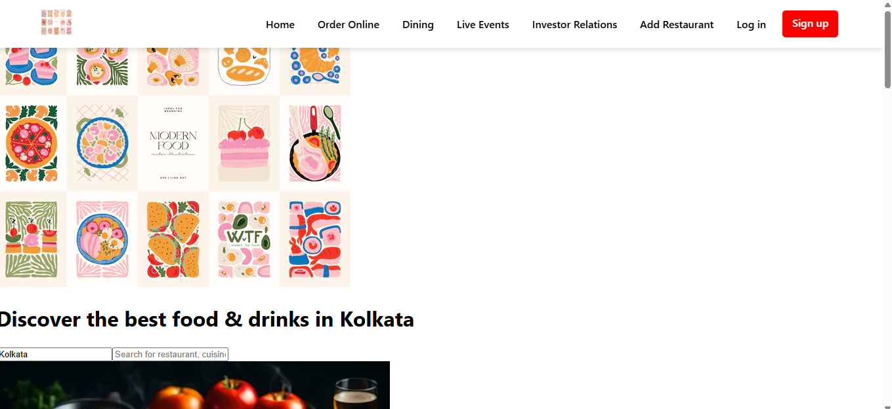
Modelling & Result

Slide 11

Conclusion
Scalability: Easily scales for advanced features like real-time order tracking and payments.
Full-Stack Efficiency: JavaScript across frontend and backend streamlines development and improves code reuse.
User Experience: React enables dynamic and visually engaging interfaces for seamless interaction.
Robust Backend: Node.js and Express.js offer powerful backend management for restaurants, users, and orders.
Feature-Rich: Supports essential food delivery app features like location-based services, payments, and reviews.
Modern & Reliable: MERN stack aligns with current development trends and strong community support.
Cost-Effective: Open-source technologies significantly reduce overall development cost.

Slide 12


Notes:
Thank You !!

